Slide 1

Customer Data Analysis
TEAM ID : PTID-CDA-NOV-25-893
PROJECT ID : PRDA-05
NAME : RAMESH KUMAR,
MONIKA RAMESH,
MIDUN RAJASEKAR R M.
EMAIL:rameshshanmu04@gmail.com ,
monikaramesh846@gmailcom,
midunrajasekarrm@gmail.com .
CAPSTONE PROJECT

Slide 2
Customer Data Analysis
Project Overview
This project analyzes real customer shopping transactions across multiple malls using SQL for data exploration and Power BI for interactive visualizations. The goal is to understand customer behavior, identify revenue drivers, and provide insights that help businesses optimize marketing, inventory, and customer engagement strategies.

Slide 3





KEY FOCUS
Gender-based buying patterns.
01uuujjkku000jjjj
Age-wise customer performance.
Category-level revenue and sales insights.
Payment method usage and preferences.
Monthly revenue trends and seasonality

Slide 4



Customer Data Analysis
Tools Used
1.SQL: Data exploration, querying, aggregations
2. Power Bl: Dashboard design, visuals, KPI tracking
3. Power Query: Data cleaning & transformation
4. DAX: Measures for dynamic analysis
5. Excel/CSV: Exporting data from SQL

Slide 5
Customer Data Analysis
Data Preparation Workflow
DATA CONNECTION
SQL DATA EXPLORATION
SQL ANALYSIS
(10 TASK)
DASHBOARD &
INSIGHT
LOAD INTO
POWER BI
EXPORT TO
EXCEL/CSV

Slide 6
Customer Data Analysis
Business Problem Analyzed
1.How is the shopping distribution according to gender?
2. Which gender did we sell more products to?
3.Which gender generated more revenue?
4. Distribution of purchase categories relative to other columns?
5. How is the shopping distribution according to age?
6. Which age cat did we sell more products to?
7. Which age cat generated more revenue?
8. Distribution of purchase categories relative to other columns?
9. Does the payment method have a relation with other columns?
10. How is the distribution of the payment method?

Slide 7
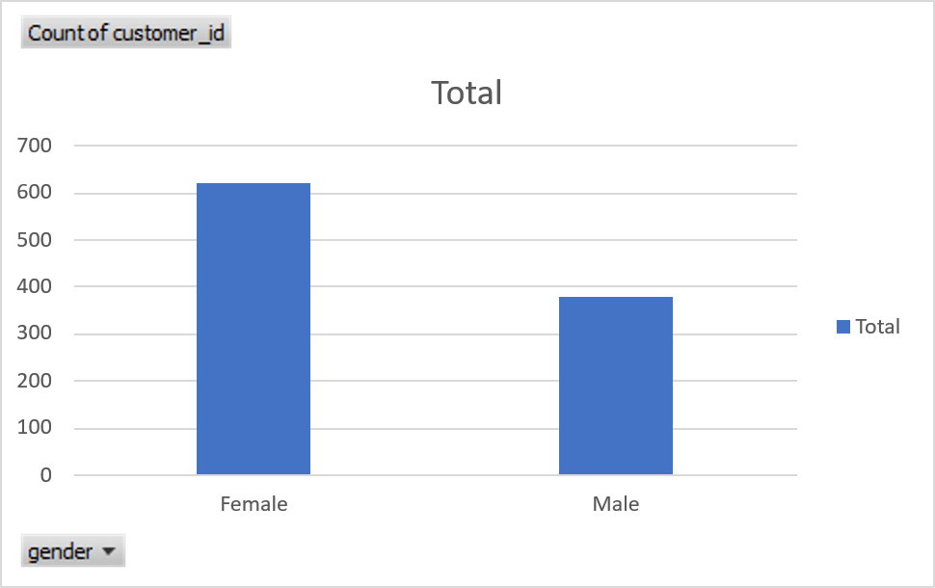

Customer Data Analysis
One gender dominates shopping activity, showing stronger engagement and higher store
interaction
1.How is the shopping distribution according to gender?

Slide 8
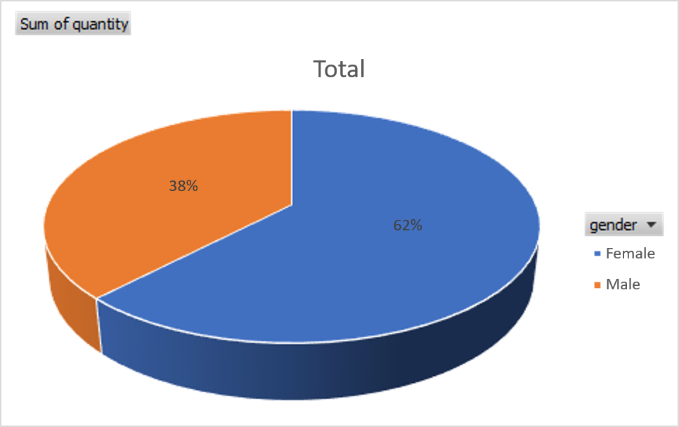

Customer Data Analysis
Higher product quantity is driven by one gender, Indicating stronger purchase frequency.
2.Which gender did we sell more products to ?

Slide 9
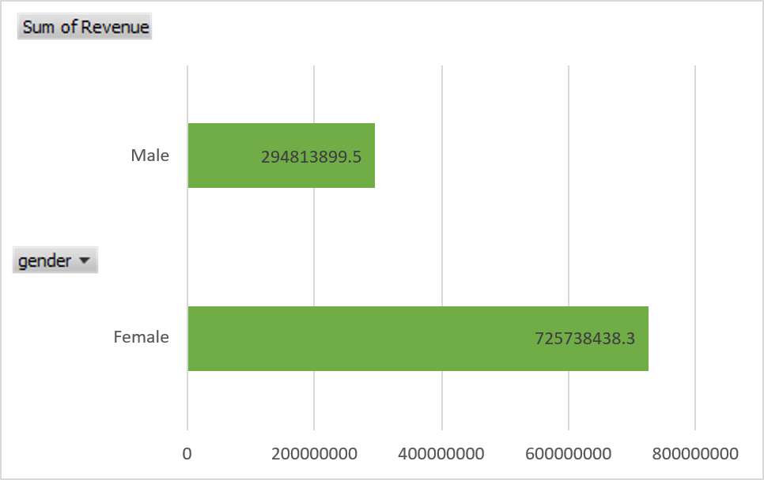

Customer Data Analysis
Revenue contribution is higher for female gender revealing a more valuable customer
segment.
3.Which gender generate more revenue ?

Slide 10
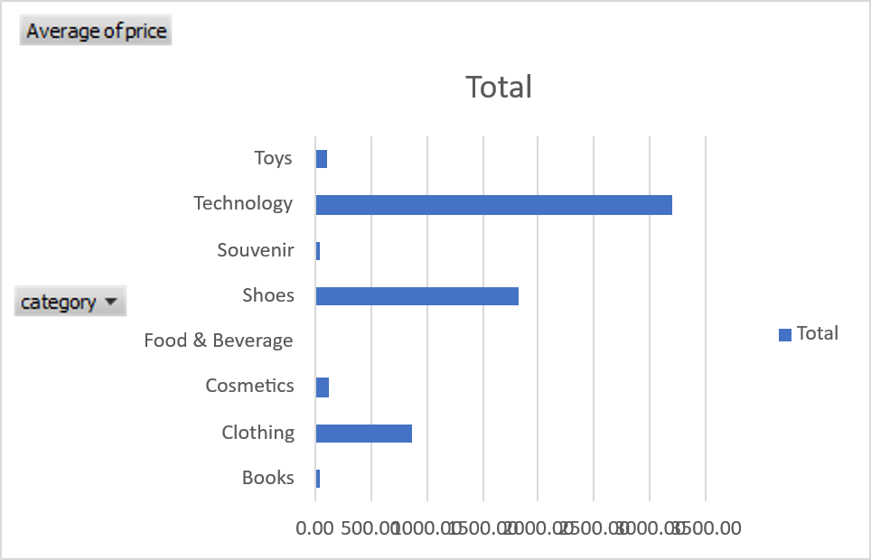
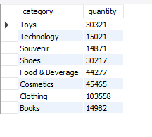
Customer Data Analysis
Top categories consistently outperform others across transaction, lems, and venue.
4.Distribution of purchase categories relative to
Other column ?

Slide 11
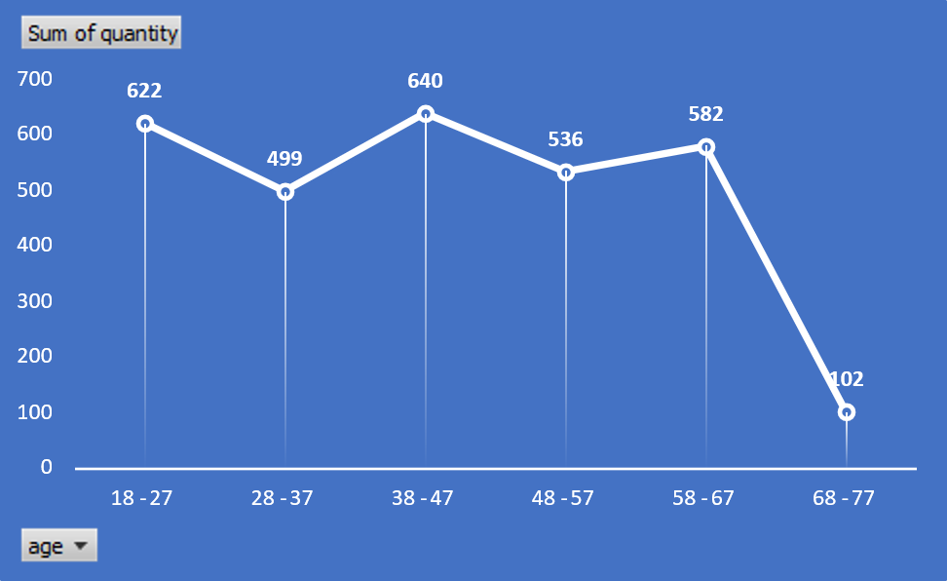
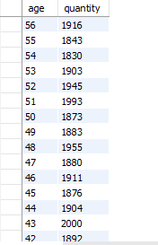
Customer Data Analysis
Specific age groups show the. highest shopping participation, shaping key customer demographics.
5.How is the shopping distribution according to age?

Slide 12
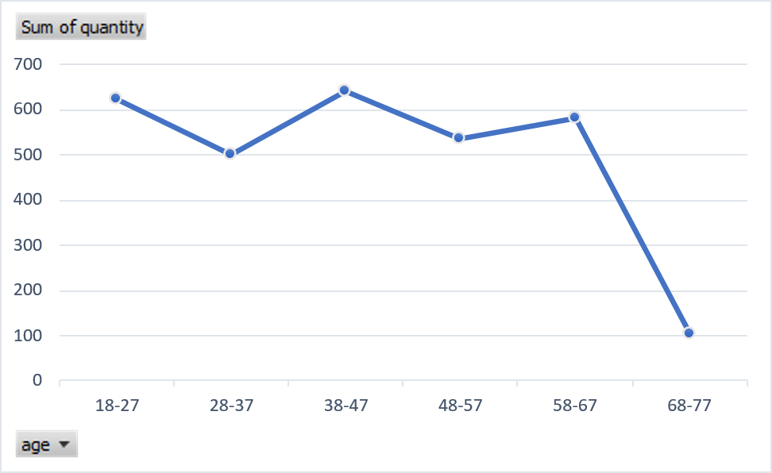
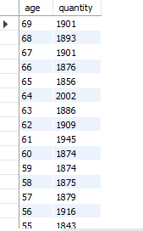
Customer Data Analysis
One age group category purchases the most items, highlighting strong buying intensity.
6.Which age cat did we sell more products to ?

Slide 13
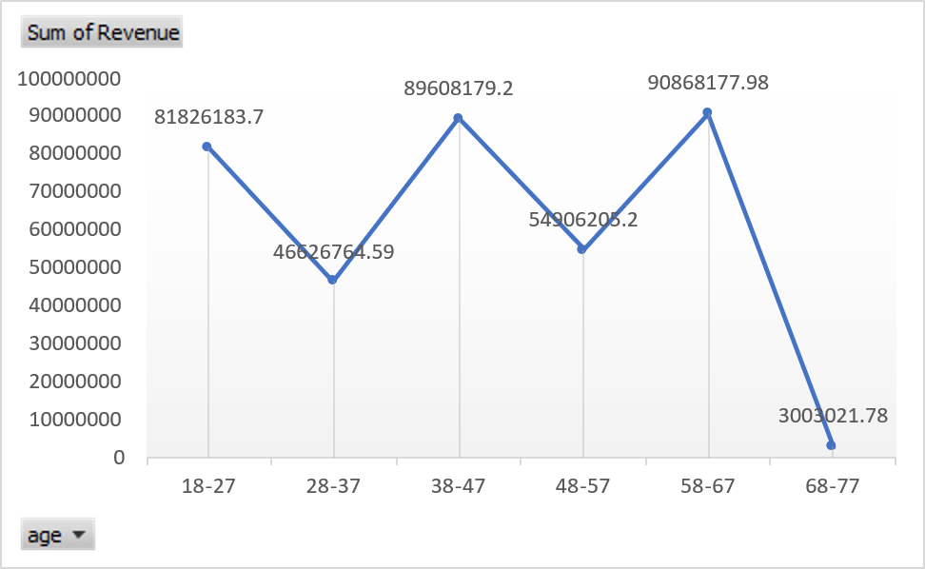
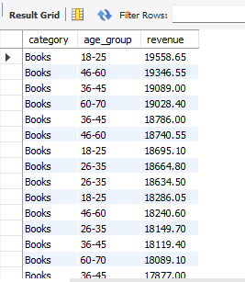
Customer Data Analysis
Revenue is largely driven by a core age group, making them the key sales
segment
7.Which age cat generate more revenue ?

Slide 14
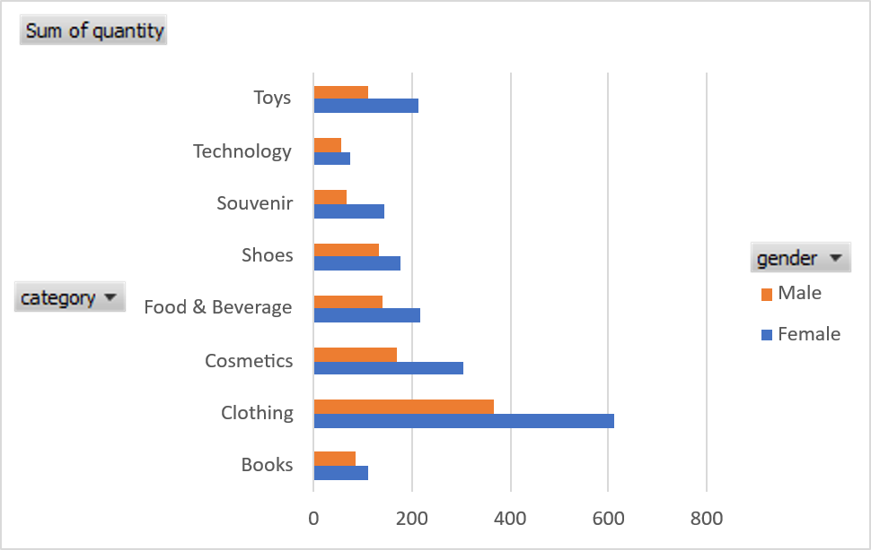
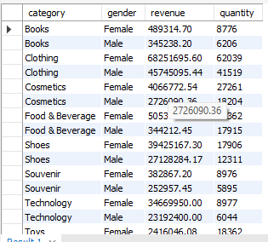
Customer Data Analysis
Product category preference vary across age and transactions, enabling targeted product
positioning
8.Distribution of purchase categories relatives to other column?

Slide 15
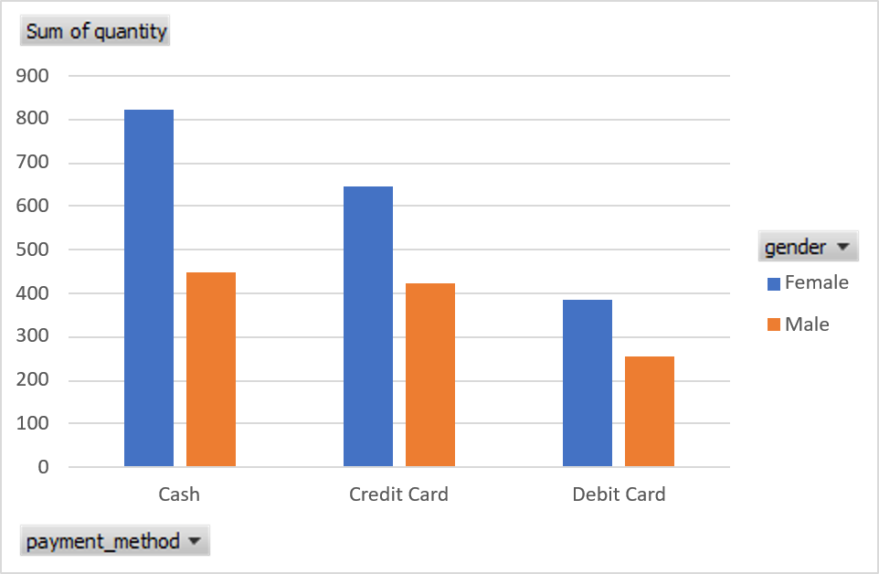
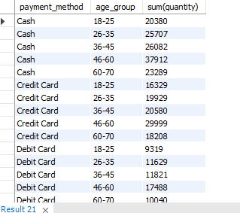
Customer Data Analysis
Payment choices differ by age gender, and category, reflecting diverse customer preferences
Customer trends
9.Does the payment method have a realation with other columns?

Slide 16
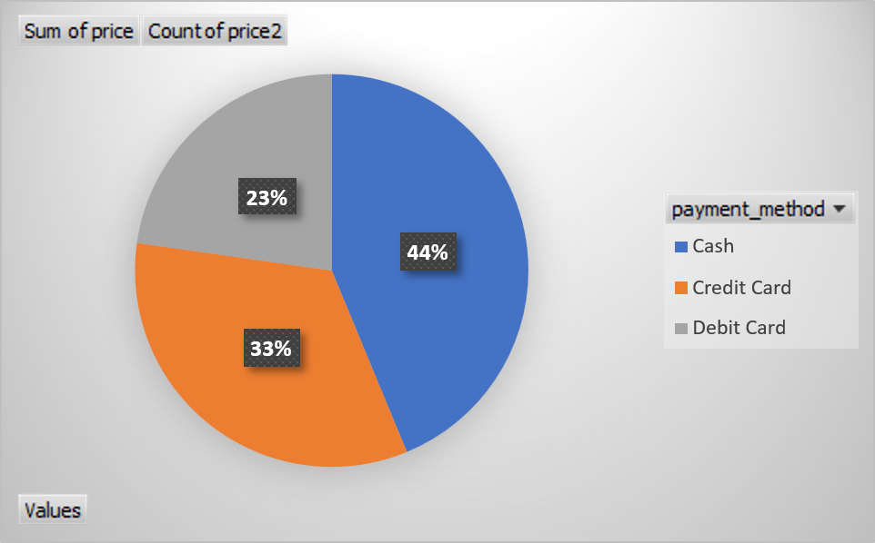
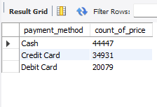
Customer Data Analysis
A cash payment method dominate transactions, confirming strong customer prefenince
trends
10.How is the distribution of the payment method?

Slide 17

Customer Data Analysis
Age 25-34 and 35-44 show the highest buying activity and spending levels.
Top-performing categories generate a major share of total sales, driving business growth overall
Cash & Cards are the most preferred modes
Female gender contributes more revenue, making it the primary high-value customer segment.

Slide 18
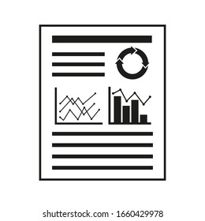




Customer Data Analysis
BUSINESS RECOMMENDATION
1. Target High-Performing Age Groupe Focus marketing and loyalty programs on the strong 25-34 and 35-44 customer segments.
2-Optimize Inventory for Tog Categories Prioritize stock and promotions for high-demand categories especially during peak months
3. Strengthen Female Focy CampaignaIntroduce targeted offers and product bundles for female shoppers if they drive higher revenue.
4. Encourage Digital PaymentsBoost UPI & card usage with cash back, discounts, and reward-based incentives
5. Deliver Personalized Product ReccomendationsUse age and gender insights to provide customized category suggestions and increase

Slide 19
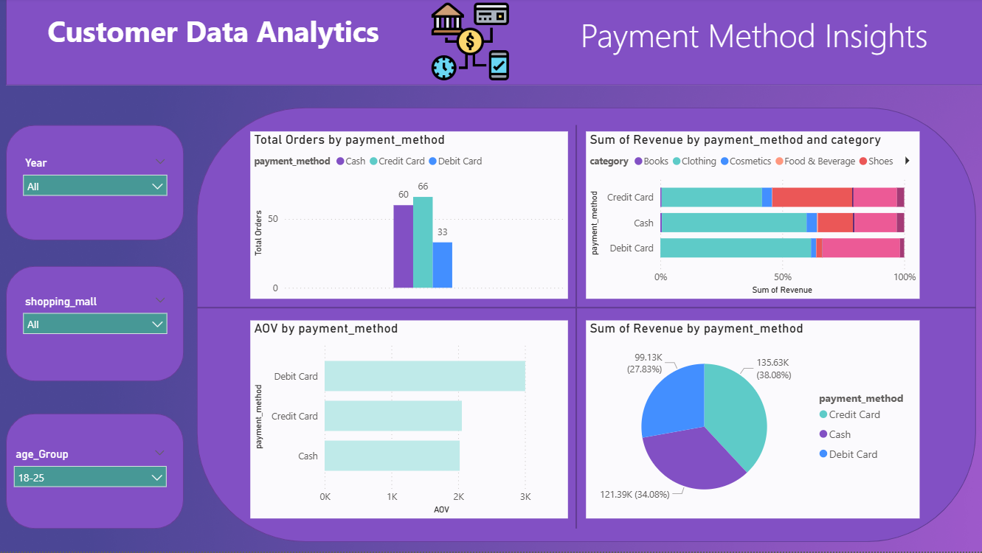
Customer Data Analysis

Slide 20
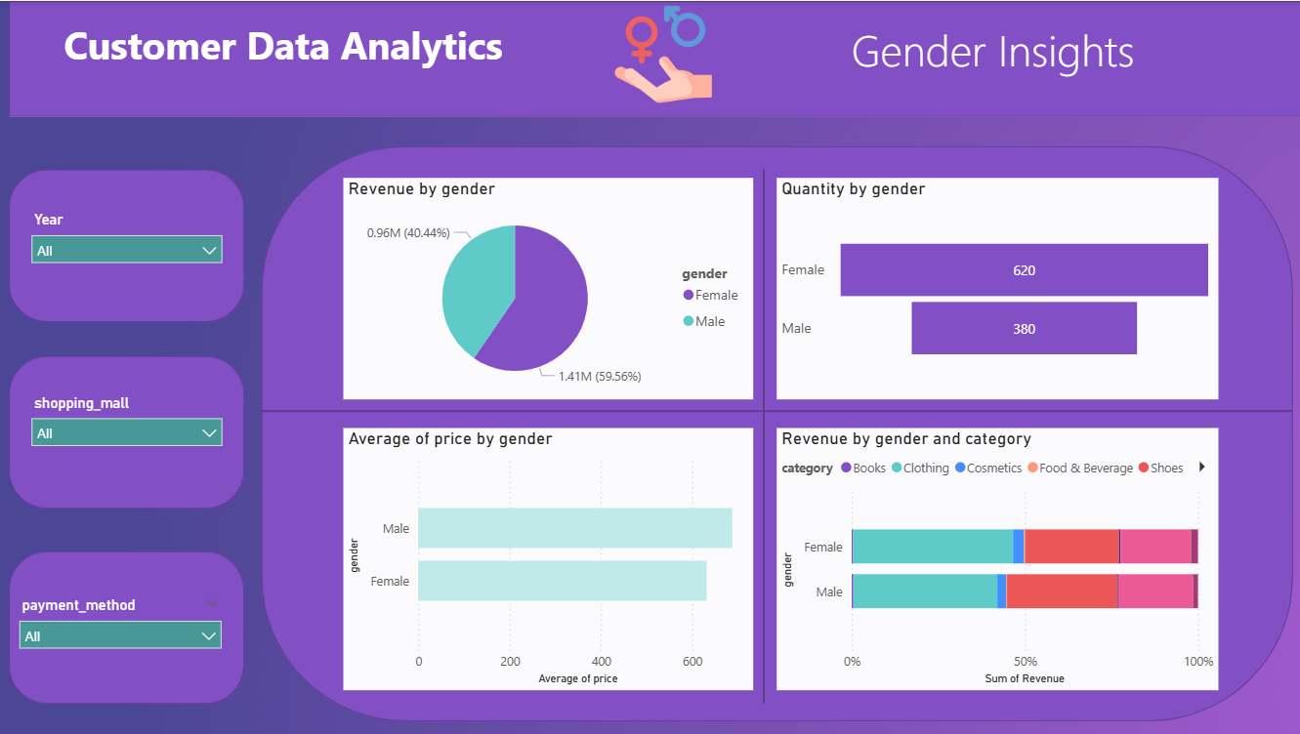
Customer Data Analysis

Slide 21
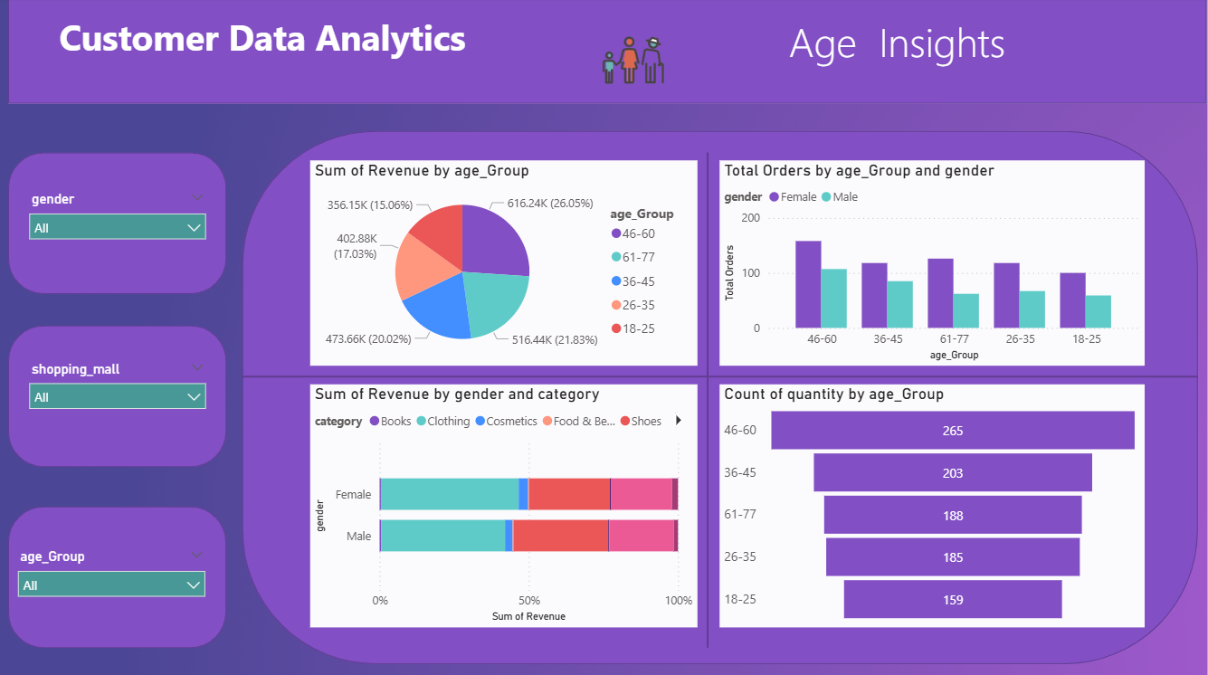
Customer Data Analysis

Slide 22
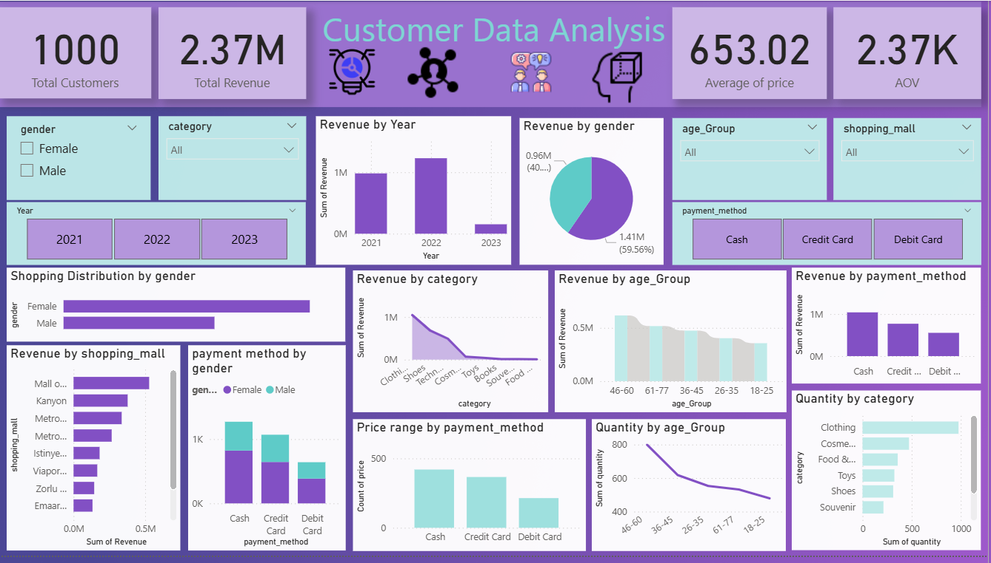
Customer Data Analysis

Slide 23


